Slide 1

Heaven’s light is our guide”
Rajshahi University of Engineering & Technology
Department of Computer Science & Engineering
Data Communication
Course No. : CSE 3103
Chapter 8: Switching
Prepared By : Julia Rahman

Slide 2
8 Switching
When there are multiple devices, the problem is how to connect them to make one-to-one communication possible.
One solution is a mesh topology or a star topology.
Limitation of these methods for large network–
Impractical (number of link and the length of the link is too much)
Wasteful (majority of those links would be idle most of the time)
cost-inefficient,
Multipoint topologies (like bus) are ruled out because the distances between devices and the total number of devices increase beyond the capacities of the media and equipment.
A better solution is switching.

Slide 3
8 Switching
A switched network consists of a series of inter-linked nodes, called switches.
Switches are devices capable of creating temporary connections between two or more devices linked to the switch.
In a switched network, some of these nodes are connected to the end systems (computers or telephones, for example).

Slide 4
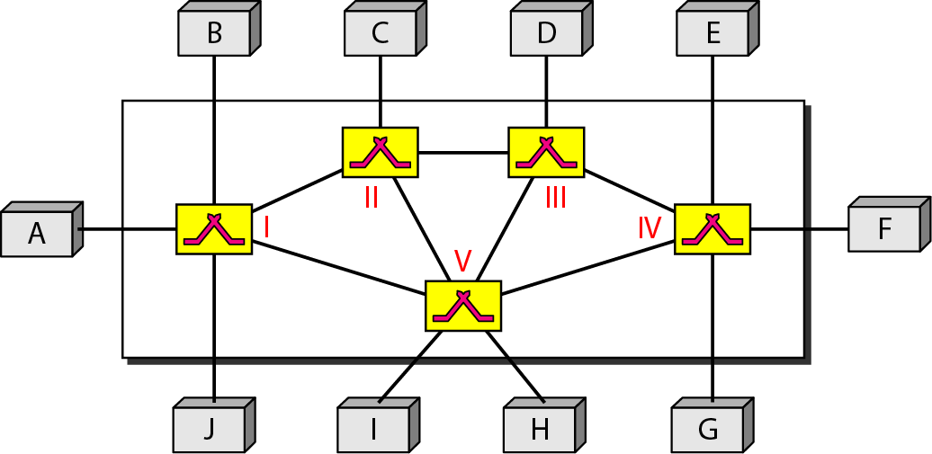
8 Switching
Figure 8.1 Switched network
The end systems (communicating devices) are labeled A, B, C, D, and so on,
The switches are labeled I, II, III, IV, and V. Each switch is connected to multiple links.

Slide 5
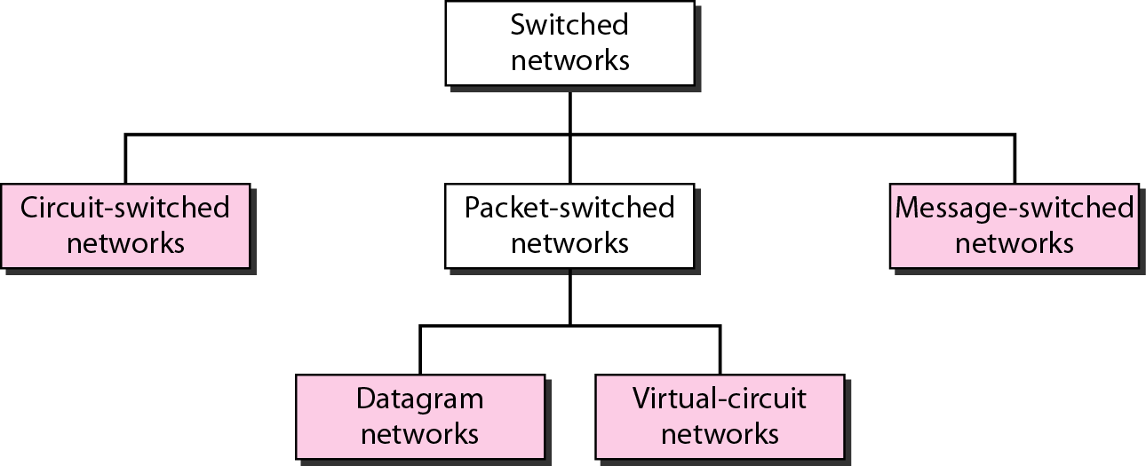
8 Switching
Figure 8.2 Taxonomy of switched networks
Circuit switching and packet switching are commonly used today.
Message switching has been phased out in general communications but still has networking applications.

Slide 6
8.1 CIRCUIT-SWITCHED NETWORKS
A circuit-switched network consists of a set of switches connected by physical links.
A connection between two stations is a dedicated path made of one or more links
Each connection uses only one dedicated channel on each link
Each link is normally divided into n channels by using FDM or TDM.
The link can be permanent (leased line) or temporary (telephone)

Slide 7
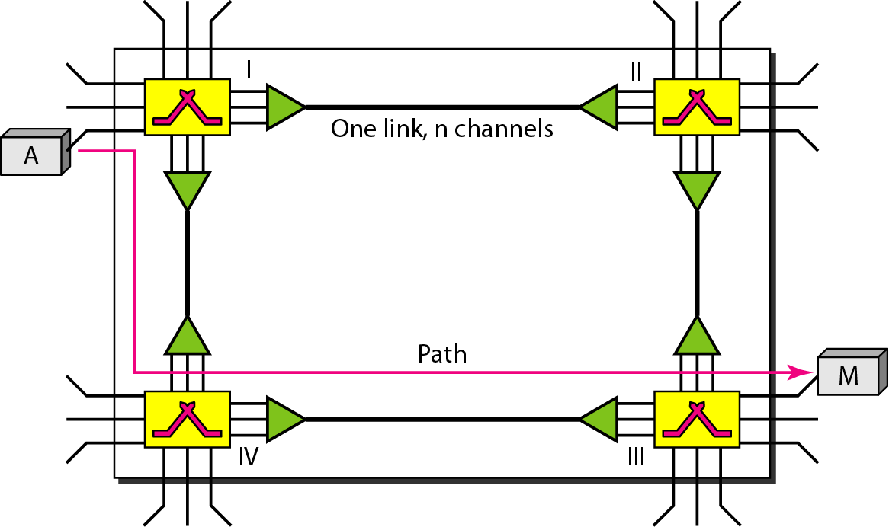
8.1 CIRCUIT-SWITCHED NETWORKS
Figure 8.3 A trivial circuit-switched network

Slide 8
8.1 CIRCUIT-SWITCHED NETWORKS
When end system A needs to communicate with end system M, system A needs to
Setup phase – request a connection to M that must be accepted by all switches as well as by M itself.
A circuit (channel) is reserved on each link, and the combination of circuits or channels defines the dedicated path.
After the dedicated path made of connected circuits (channels) is established, data transfer can take place.
After all data have been transferred, the circuits are teardown.

Slide 9
8.1 CIRCUIT-SWITCHED NETWORKS
We need to emphasize several points here:
Circuit switching takes place at the physical layer.
Before starting communication, the stations must make a reservation for the resources to be used during the communication. These resources, such as channels (bandwidth in FDM and time slots in TDM), switch buffers, switch processing time, and switch input/output ports, must remain dedicated during the entire duration of data transfer until the teardown phase.
Data transferred between the two stations are not packetized. The data are a continuous flow sent by the source station and received by the destination station, although there may be periods of silence.
There is no addressing involved during data transfer. The switches route the data based on their occupied band (FDM) or time slot (TDM). Of course, there is end-to end addressing used during the setup phase, as we will see shortly.

Slide 10
8.1 CIRCUIT-SWITCHED NETWORKS
Three Phases – connection setup, data transfer, and connection teardown.
Setup Phase
A dedicated circuit needs to be established by sending a request
“A” sends a setup request that includes the address of system M, to switch I.
Switch I finds a channel between itself and switch IV that can be dedicated for this purpose. Switch I sends request to switch IV → to switch III.
Switch III informs M of system A's intention at this time.
Make a connection by acknowledgment from system M to system A by in the opposite direction.
Only after receiving acknowledgment by A connection established.

Slide 11
8.1 CIRCUIT-SWITCHED NETWORKS
Setup Phase (cont.)

Slide 12
8.1 CIRCUIT-SWITCHED NETWORKS
Three Phases – connection setup, data transfer, and connection teardown.
Data transfer phase
After the establishment of the dedicated circuit (channels), the two parties can transfer data.
Teardown phase
Signal is sent to each switch to release resources

Slide 13
8.1 CIRCUIT-SWITCHED NETWORKS
Efficiency
Not efficient as the other two types of networks because resources are allocated during the entire duration of the connection.
These resources are unavailable to other connections
Delay
Delay is minimal
During data transfer the data are not delayed at each switch; the resources are allocated for the duration of the connection.

Slide 14
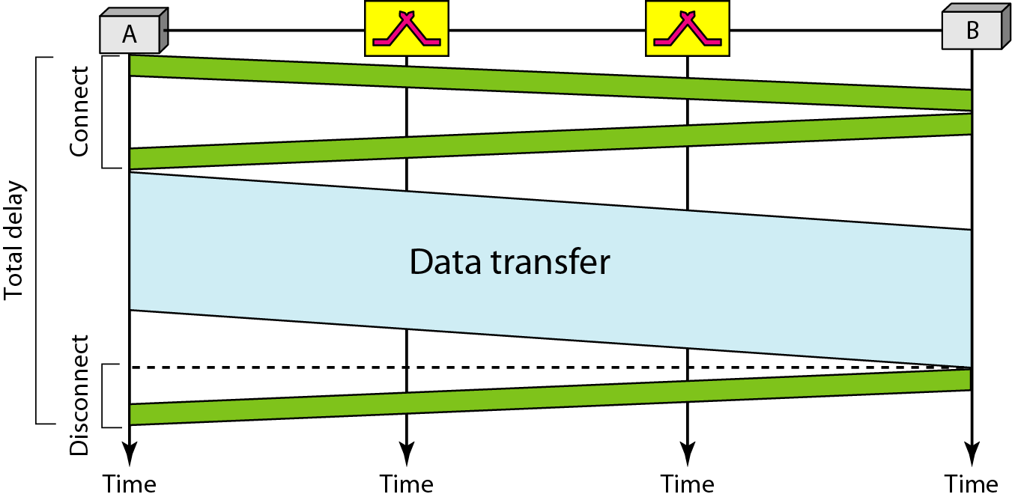
8.1 CIRCUIT-SWITCHED NETWORKS
Figure 8.6 Delay in a circuit-switched network

Slide 15
8.2 DATAGRAM NETWORKS
Data are transmitted in discrete units called packets
Size of the packet depends on the protocol and network
Packets switched networks are connectionless, hence no resource allocation. This means that there is no reserved bandwidth on the links, and there is no scheduled processing time for each packet.
Connectionless means the switch does not keep information about the connection state.
Resources are allocated on demand.
The allocation is done on a first come, first-served basis. When a switch receives a packet, no matter what is the source or destination, the packet must wait if there are other packets being processed.
Datagram switching is done at network layer

Slide 16
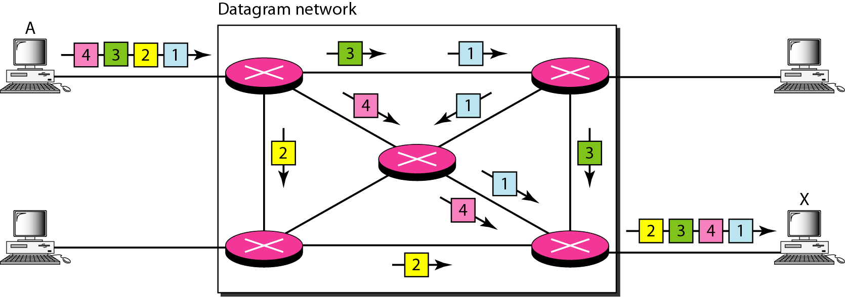
8.2 DATAGRAM NETWORKS
Figure 8.7 A datagram network with four switches (routers)

Slide 17
8.2 DATAGRAM NETWORKS
Routing table
No setup or teardown phases
Each switch (or packet switch) has a routing table which is based on the destination address.
The routing tables are dynamic and are updated periodically.
The destination addresses and the corresponding forwarding output ports are recorded in the tables.
This is different from the table of a circuit switched network in which each entry is created when the setup phase is completed and deleted when the teardown phase is over.

Slide 18
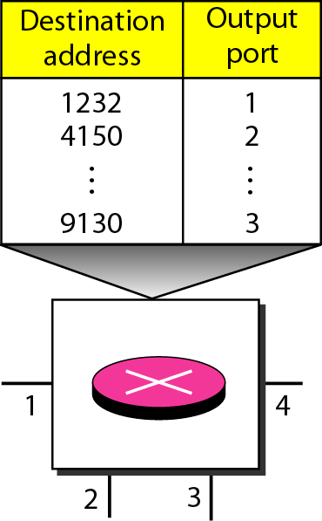
8.2 DATAGRAM NETWORKS
Routing table (cont.)
Figure 8.8 Routing table in a datagram network

Slide 19
8.2 DATAGRAM NETWORKS
Destination Address
Every packet carries a header that contains, among other information, the destination address of the packet.
When the switch receives the packet, this destination address is examined; the routing table is consulted to find the corresponding port through which the packet should be forwarded.
This address, unlike the address in a virtual-circuit-switched network, remains the same during the entire journey of the packet.

Slide 20
8.2 DATAGRAM NETWORKS
Efficiency
The efficiency of a datagram network is better than that of a circuit-switched network;
Resources are allocated only when there are packets to be transferred.
Delay
Greater delay in a datagram network than in a virtual-circuit network.
No setup and teardown phases, each packet may experience a wait at a switch before it is forwarded.
In addition, since not all packets in a message necessarily travel through the same switches, the delay is not uniform for the packets of a message.

Slide 21
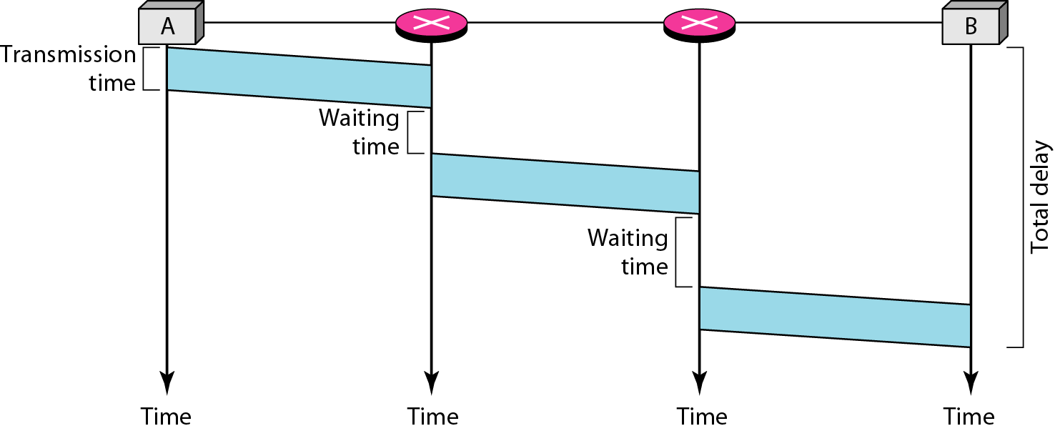
8.2 DATAGRAM NETWORKS
Total Delay = 3T + 3t+ w1+ w2
Figure 8.9 Delay in a datagram network

Slide 22
8.3 VIRTUAL-CIRCUIT NETWORKS
A virtual-circuit network is a cross between a circuit-switched network and a datagram network.
It has some characteristics of both.
As in a circuit-switched network, there are setup and teardown phases in addition to the data transfer phase.
Resources can be allocated during the setup phase, as in a circuit-switched network, or on demand, as in a datagram network.
As in a datagram network, data are packetized and each packet carries an address in the header.
As in a circuit-switched network, all packets follow the same path established during the connection.
A virtual-circuit network is normally implemented in the data link layer, while a circuit-switched network is implemented in the physical layer and a datagram network in the network layer.

Slide 23
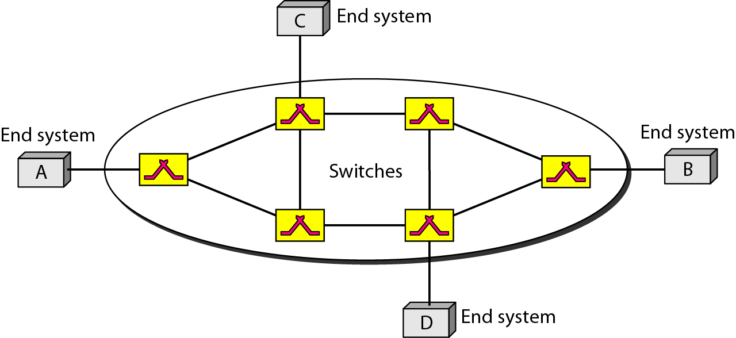
8.3 VIRTUAL-CIRCUIT NETWORKS
Figure 8.10 Virtual-circuit network

Slide 24
8.3 VIRTUAL-CIRCUIT NETWORKS
Addressing
Two types of addressing are involved: global and local (virtual-circuit identifier).
Global Addressing
A source or a destination needs to have a global address – unique addresses
Virtual-Circuit Identifier
The identifier that is actually used for data transfer is called the virtual-circuit identifier (VCI).
A VCI, unlike a global address, is a small number that has only switch scope;
It is used by a frame between two switches.
When a frame arrives at a switch, it has a VCI; when it leaves, it has a different VCl.

Slide 25
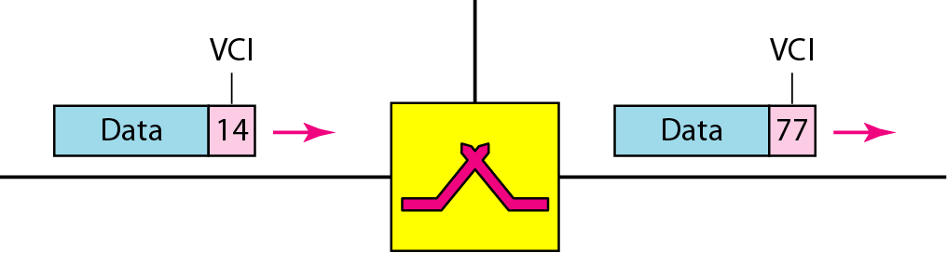
8.3 VIRTUAL-CIRCUIT NETWORKS
Addressing (cont.)
Figure 8.11 Virtual-circuit identifier

Slide 26
8.3 VIRTUAL-CIRCUIT NETWORKS
Transmission Three Phases
Setup Phase
source and destination use their global addresses to help switches make table entries for the connection.
A switch creates an entry for a virtual circuit
Suppose source A needs to create a virtual circuit to B. Two steps are required: the setup request and the acknowledgment.
Setup Request: A setup request frame is sent from the source to the destination
Acknowledgment: A special frame, called the acknowledgment frame, completes the entries in the switching tables

Slide 27
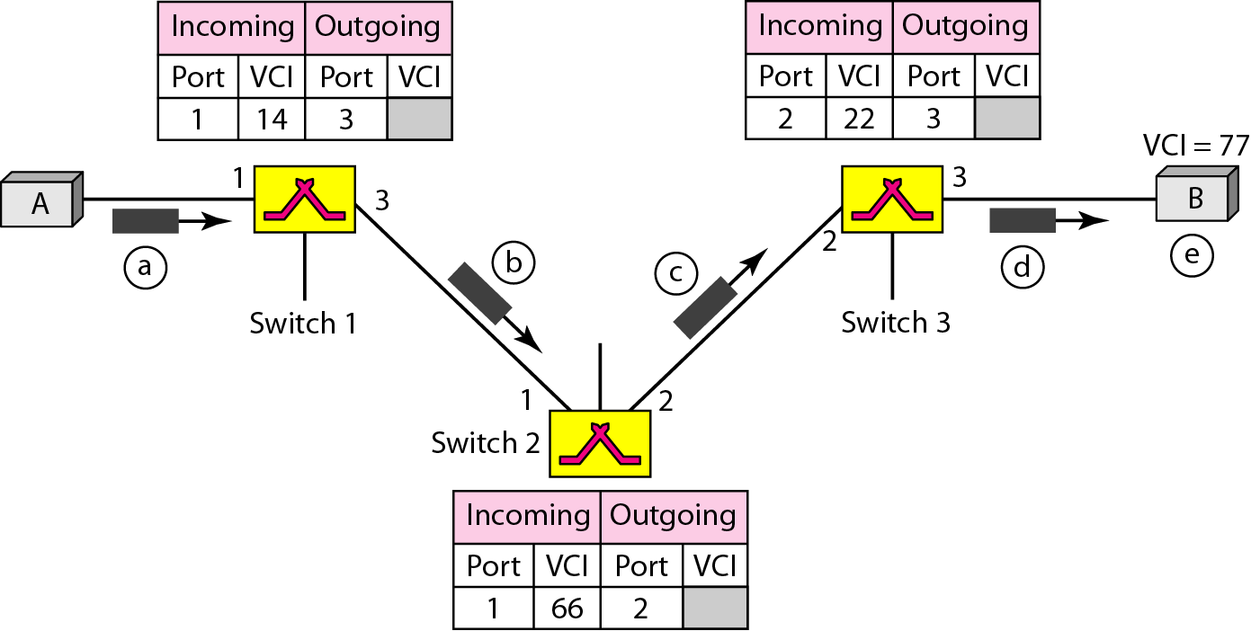
8.3 VIRTUAL-CIRCUIT NETWORKS
Transmission Three Phases
Setup Phase (cont.)
Figure 8.14 Setup request in a virtual-circuit network

Slide 28
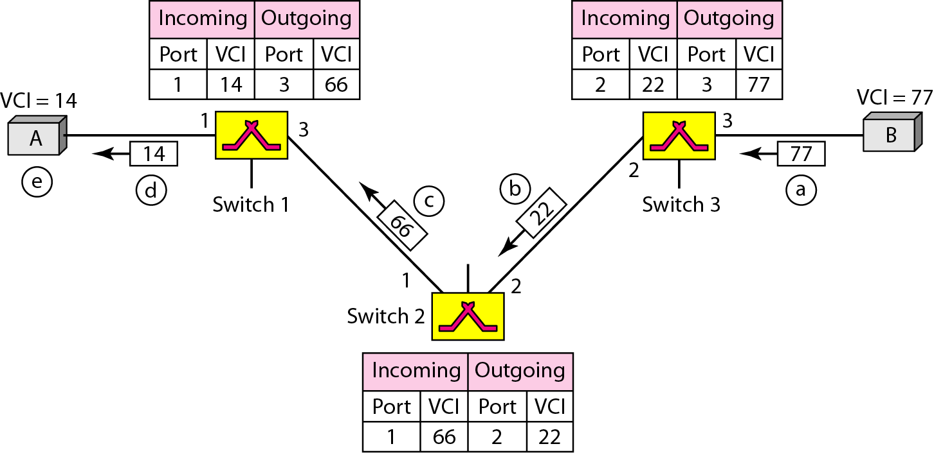
8.3 VIRTUAL-CIRCUIT NETWORKS
Transmission Three Phases
Setup Phase (cont.)
Figure 8.15 Setup acknowledgment in a virtual-circuit network

Slide 29
8.3 VIRTUAL-CIRCUIT NETWORKS
Transmission Three Phases
Data Transfer Phase
To transfer a frame from a source to its destination, all switches need to have a table entry for this virtual circuit.
The table, in its simplest form, has four columns.
This means that the switch holds four pieces of information for each virtual circuit that is already set up.
The data transfer phase is active until the source sends all its frames to the destination.
The procedure at the switch is the same for each frame of a message.
The process creates a virtual circuit, not a real circuit, between the source and destination.

Slide 30
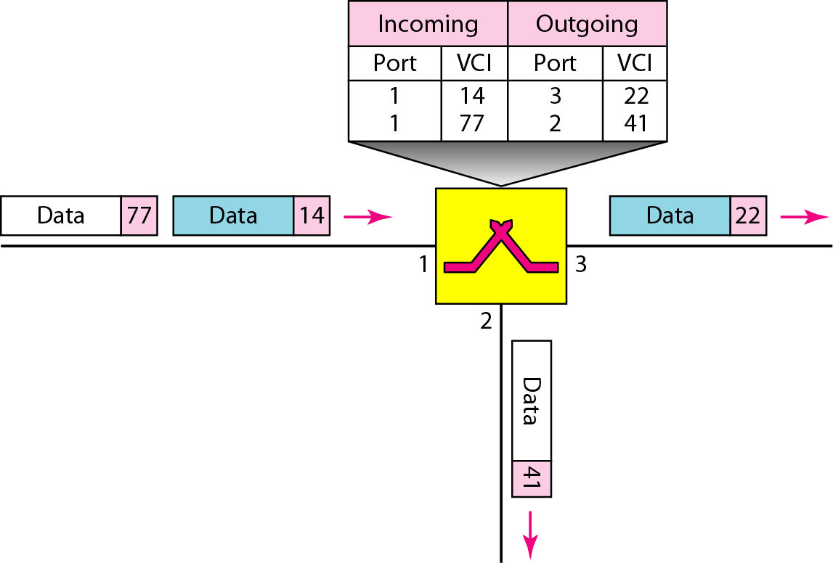
8.3 VIRTUAL-CIRCUIT NETWORKS
Transmission Three Phases
Data Transfer Phase (cont.)
Figure 8.12 Switch and tables in a virtual-circuit network

Slide 31
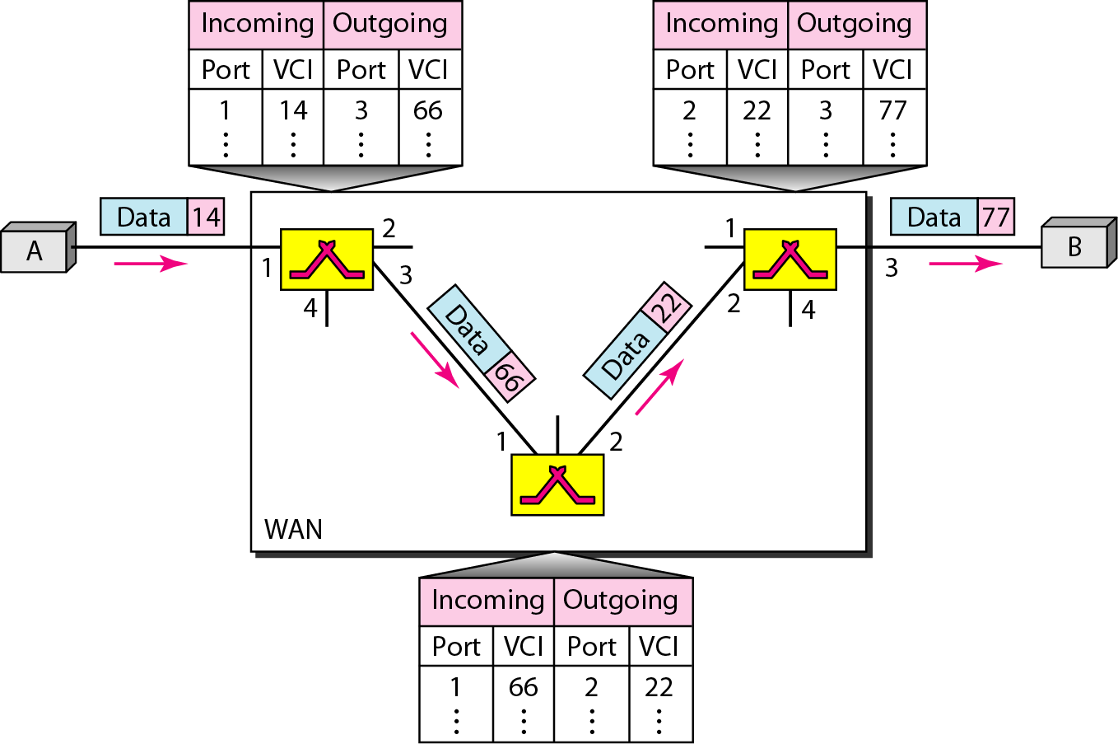
8.3 VIRTUAL-CIRCUIT NETWORKS
Transmission Three Phases
Data Transfer Phase (cont.)
Figure 8.13 Source-to-destination data transfer in a virtual-circuit network

Slide 32
8.3 VIRTUAL-CIRCUIT NETWORKS
Transmission Three Phases
Teardown Phase
In this phase, source A, after sending all frames to B, sends a special frame called a teardown request.
Destination B responds with a teardown confirmation frame.
All switches delete the corresponding entry from their tables.

Slide 33
8.3 VIRTUAL-CIRCUIT NETWORKS
Efficiency
In virtual-circuit switching, all packets belonging to the same source and destination travel the same path;
But the packets may arrive at the destination with different delays if resource allocation is on demand.
There is one big advantage in a virtual-circuit network even if resource allocation is on demand.
Delay
One-time delay for setup and a one-time delay for teardown.
If resources are allocated during the setup phase, there is no wait time for individual packets.

Slide 34
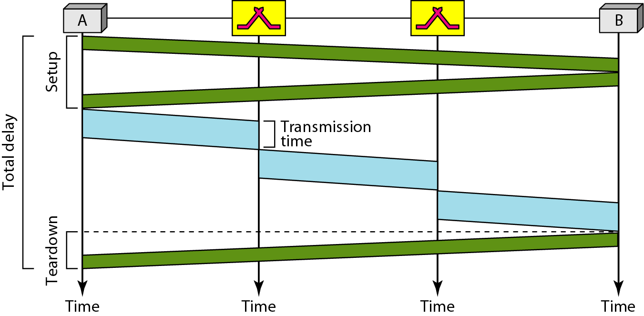
8.3 VIRTUAL-CIRCUIT NETWORKS
Total delay = 3T + 3ζ+ setup delay + teardown delay
Figure 8.16 Delay in a virtual-circuit network

Slide 35
8.4 STRUCTURE OF A SWITCH
Structure of Circuit Switches
Two technologies: the space-division switch or the time-division switch.
Space-division switch:
The paths in the circuit are separated from one another spatially.
This technology was originally designed for use in analog networks but is used currently in both analog and digital networks.
Crossbar Switch
connects n inputs to m outputs in a grid, using electronic micro-switches (transistors) at each cross-point
Major limitation – huge number of cross-points required. To connect n inputs to m outputs using a crossbar switch requires n x m cross-points. Only fewer than 25 percent of the cross-points are in use at any given time.

Slide 36
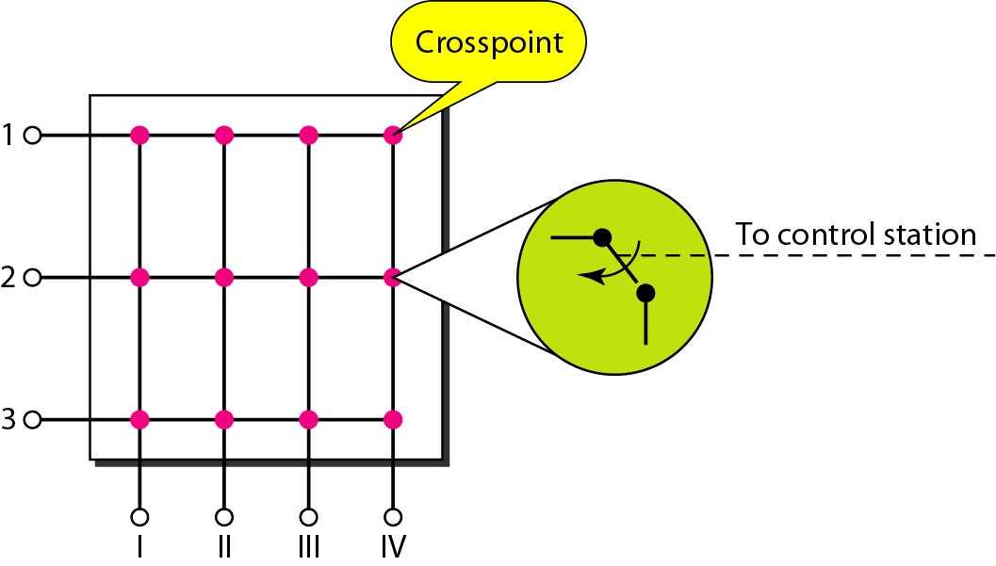
8.4 STRUCTURE OF A SWITCH
Figure 8.17 Crossbar switch with three inputs and four outputs

Slide 37
8.4 STRUCTURE OF A SWITCH
Space-division switch (cont.):
Multistage Switch
The solution of the crossbar switch limitation is the multistage switch, which combines crossbar switches in several (normally three) stages.
To design a three-stage switch, we follow these steps:
We divide the N input lines into groups, each of n lines. For each group, we use one crossbar of size n x k, where k is the number of crossbars in the middle stage.
We use k crossbars, each of size (N/n) x (N/n) in the middle stage.
We use N/n crossbars, each of size k x n at the third stage.
Drawback – blocking during periods of heavy traffic

Slide 38
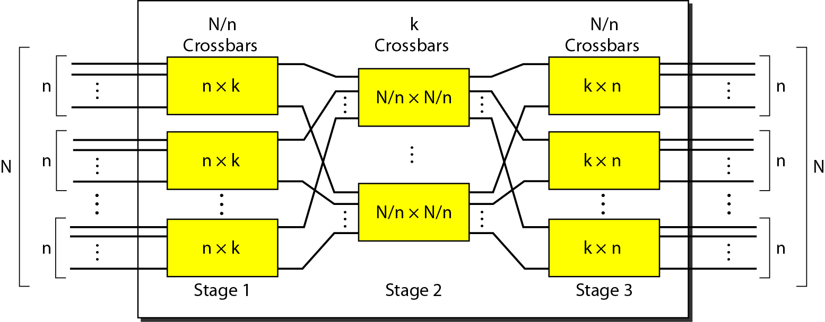
8.4 STRUCTURE OF A SWITCH
Figure 8.18 Multistage switch

Slide 39
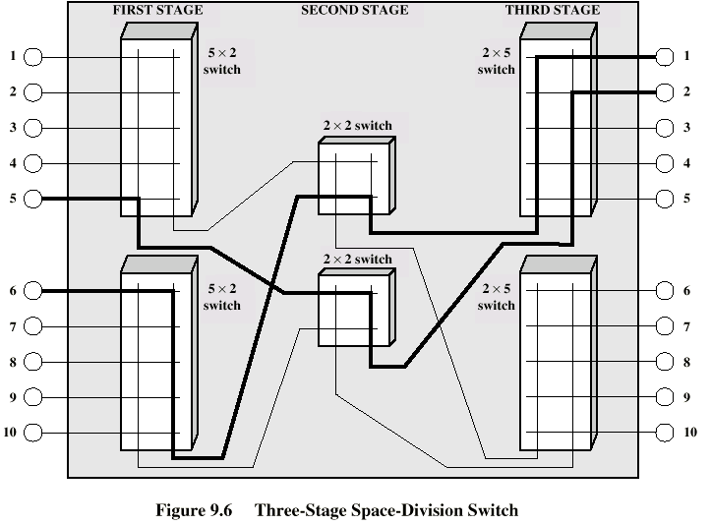
8.4 STRUCTURE OF A SWITCH

Slide 40
8.4 STRUCTURE OF A SWITCH
Structure of Circuit Switches
Time-division switch:
Uses time-division multiplexing (TDM) inside a switch.
Time-Slot Interchange
Figure 8.19 shows a system connecting four input lines to four output lines.
Imagine that each input line wants to send data to an output line according to the pattern shown in figure.

Slide 41
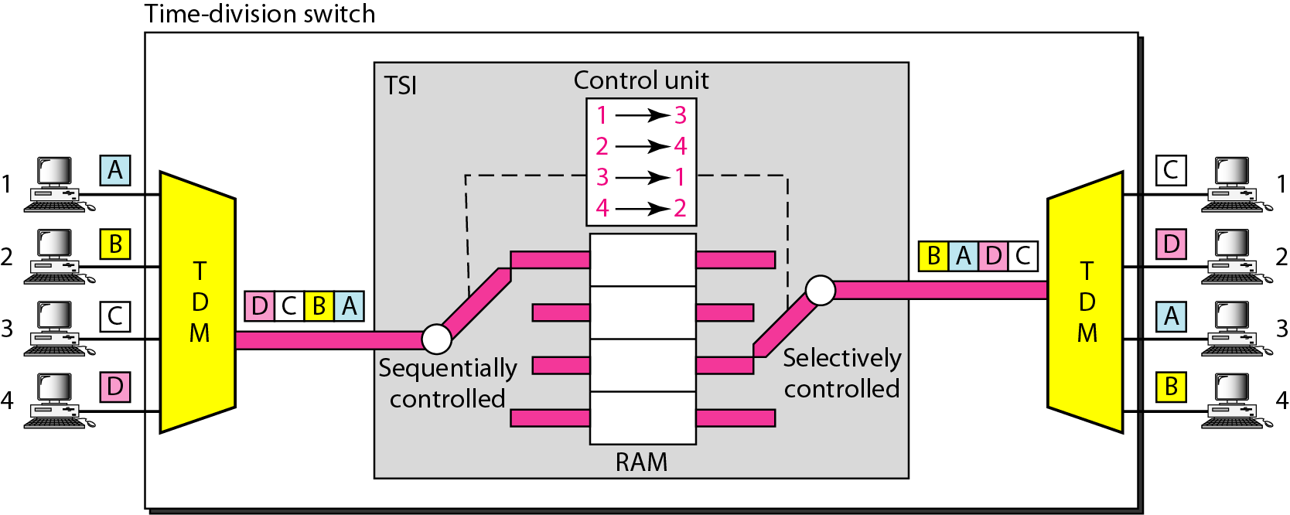
8.4 STRUCTURE OF A SWITCH
Figure 8.19 Time-slot interchange

Slide 42
8.4 STRUCTURE OF A SWITCH
Structure of Circuit Switches
Time- and Space-Division Switch Combinations:
The advantage of space-division switching is instantaneous.
Its disadvantage is the number of crosspoints required to make space-division switching acceptable in terms of blocking.
The advantage of time-division switching is that it needs no crosspoints.
Its disadvantage, in the case of TSI, is that processing each connection creates delays. Each time slot must be stored by the RAM, then retrieved and passed on.
Combine space-division and time-division technologies to take advantage of the best of both.
Combining the two results in switches that are optimized both physically (the number of crosspoints) and temporally (the amount of delay). Multistage switches of this sort can be designed as time-space-time (TST) switch.

Slide 43
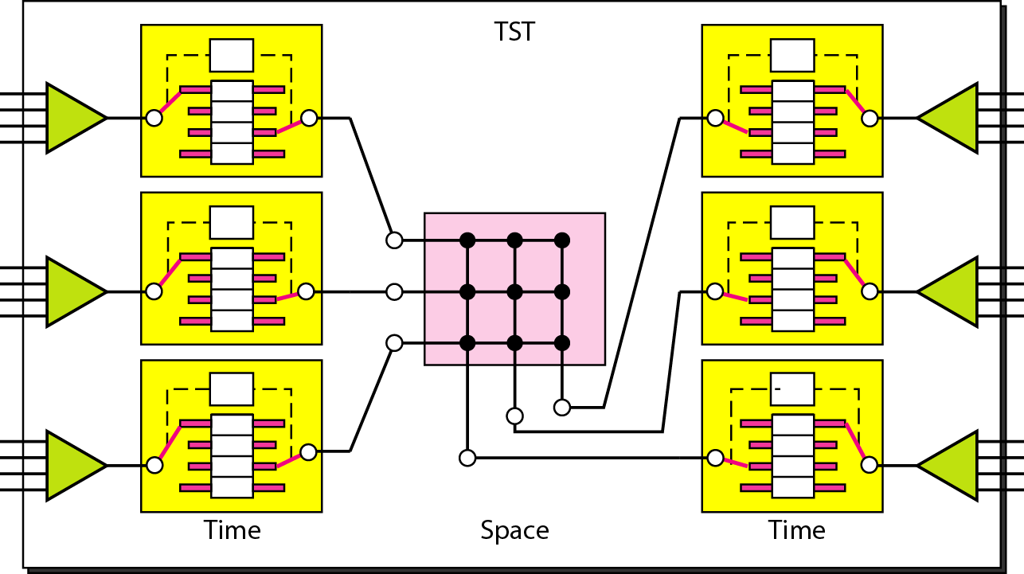
8.4 STRUCTURE OF A SWITCH
Figure 8.20 Time-space-time switch

